Slide 1
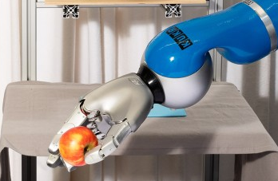
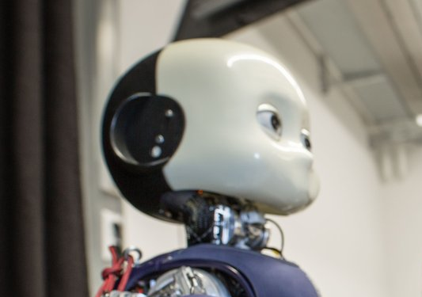
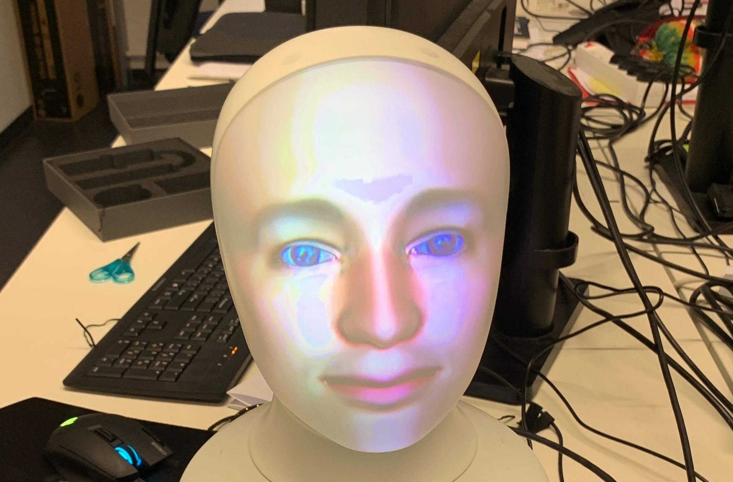
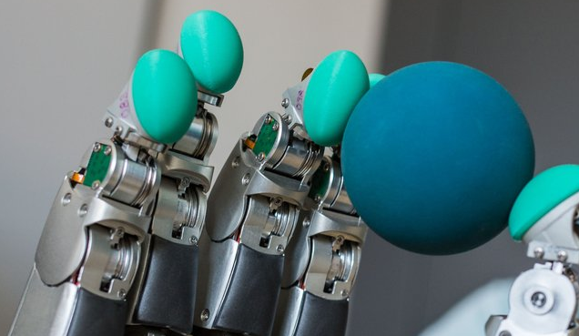
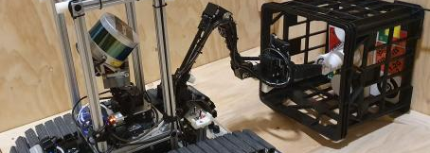
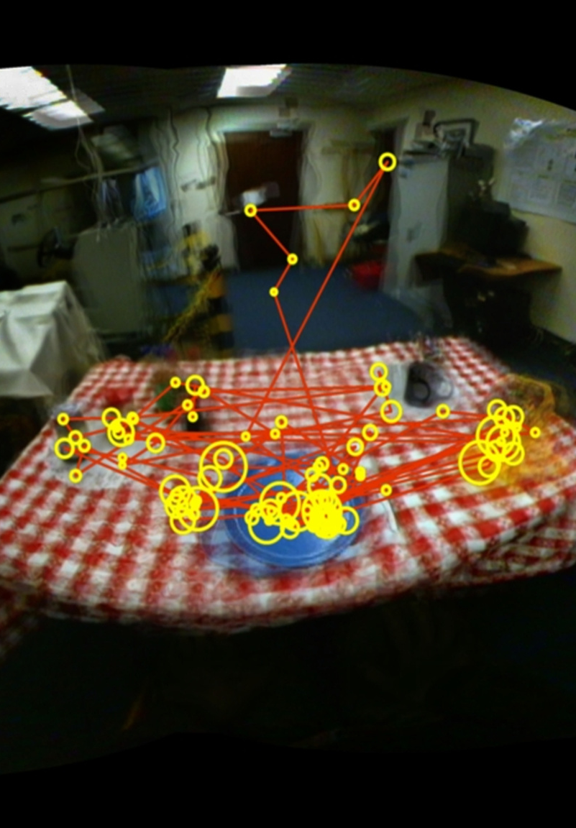
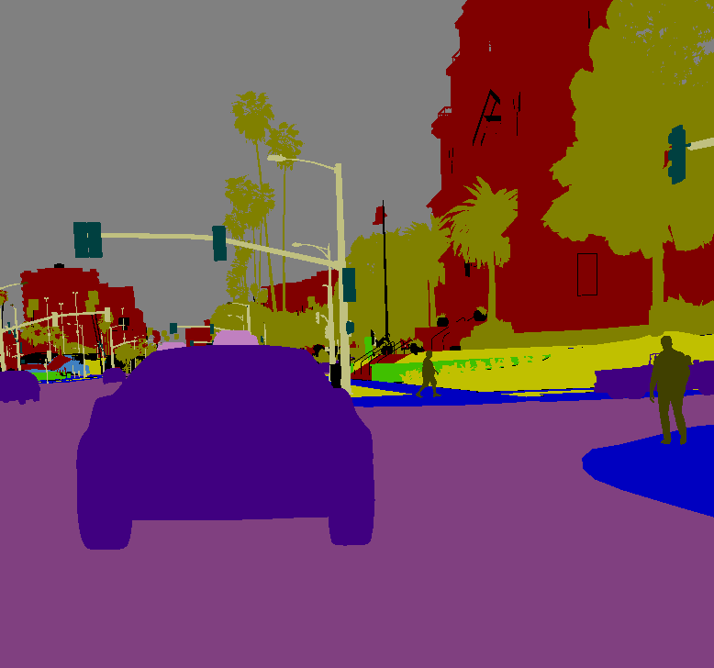

Slide 2
HessianAI

Slide 3
A
Hessian
The Hessian Center for
Artificial Intelligence

Slide 4
Hessian
AI
The Hessian Center for
Artificial Intelligence

Slide 5
hessian
AI
The Hessian Center for
Artificial Intelligence

Slide 6
The
Hessian
AI
Center for

Slide 7
Hessian
AI
The
Center for

Slide 8
Hessian
The
AI
Center for

Slide 9
[H]
H(AI)

Slide 10
hessian
AI

Slide 11
Hessian
The
Center for
AI

Slide 12
Hessian
AI
The
Center for

Slide 13
Hessian
AI
The
Center for

Slide 14
Hessian
AI
The
Center for

Slide 15
Hessian
AI
The
Center for

Slide 16
The
Hessian
Center for
AI

Slide 17
AI
The
Hessian
Center for

Slide 18
Hessian
AI
for
The Hessian Center
Hessian
The
Center for
AI

Slide 19
Hessian
AI
Hessian
The
Center for
AI

Slide 20
The | Hessian
Center for | AI

Slide 21
The | Hessian
Center | for AI

Slide 22
The | Hessian
Center for | AI

Slide 23
hessianA

Slide 24

hessian.AI
∂²AI
AI

Slide 25
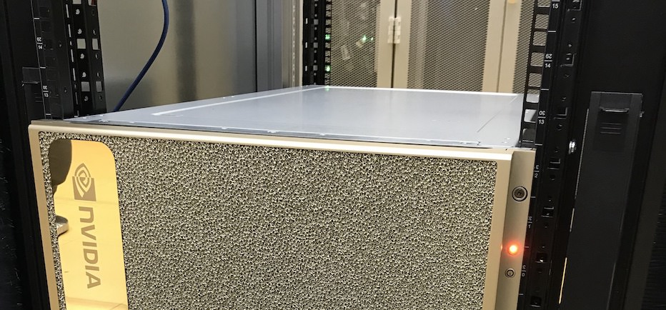

Slide 26
∂²AI
AI
d²AI
∂
∂²AI
AI
AI

Slide 27
